Slide 1
Welcome to all
for the MHRM Online lecture
By
Dr. Dhiraj Ovhal
HOD of Commerce

Slide 2
Q.5 Traditional Marketing Management VS Strategic Marketing Management
(Shortcut to remember)
(M² N² S . RTO)

Slide 3
Particular |  | Traditional Marketing Management | Strategic Marketing Management
1 | Meaning | CS +Profit+ | Process adopted by firm to differentiate from competitors by providing superior value to its customers.
2 | MR | NO | YES
3 | Nature of Decision making | Reactive | Proactive
4 | Nature of Strategy | Stable | Growth
5 | Swot | No | Yes
6 | Relationship with customer | No | Yes
7 | Time frame | Short | Long
8 | Opportunity | No | Yes
9 | Objectives | Profit | Social and economic activities

Slide 4
Particular |  | Traditional Marketing Management
1 | Meaning | It is basically focused on Customers Satisfaction +Profit+
2 | MR | NO
3 | Nature of Decision making | Reactive
4 | Nature of Strategy | Stable
5 | Swot | No
6 | Relationship with customer | No
7 | Time frame | Short
8 | Opportunity | No
9 | Objectives | Profit

Slide 5
Particular |  | Strategic Marketing Management
1 | Meaning | Process adopted by firm to differentiate from competitors by providing superior value to its customers.
2 | MR | YES
3 | Nature of Decision making | Proactive
4 | Nature of Strategy | Growth
5 | Swot | Yes
6 | Relationship with customer | Yes
7 | Time frame | Long
8 | Opportunity | Yes
9 | Objectives | Social and economic activities

Slide 6
Thank You

Slide 7
Attendance Link
https://forms.gle/Xqvykv5vfEi1zpyF7
Last point mention today date in feedback link

Slide 8
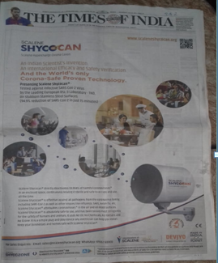

Slide 12
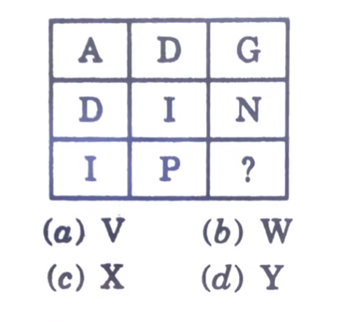

Slide 13
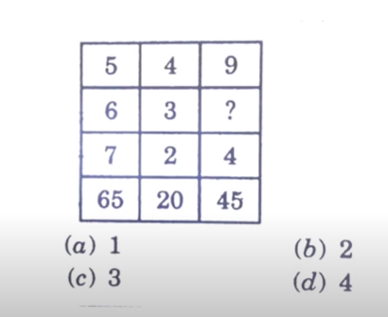

Slide 14
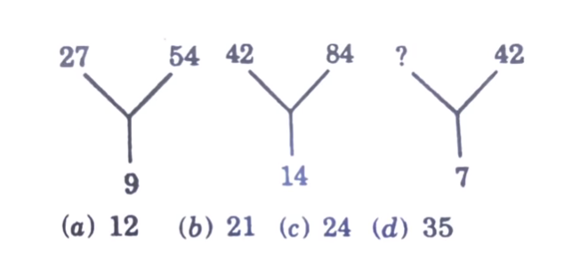

Slide 15
